Slide 1
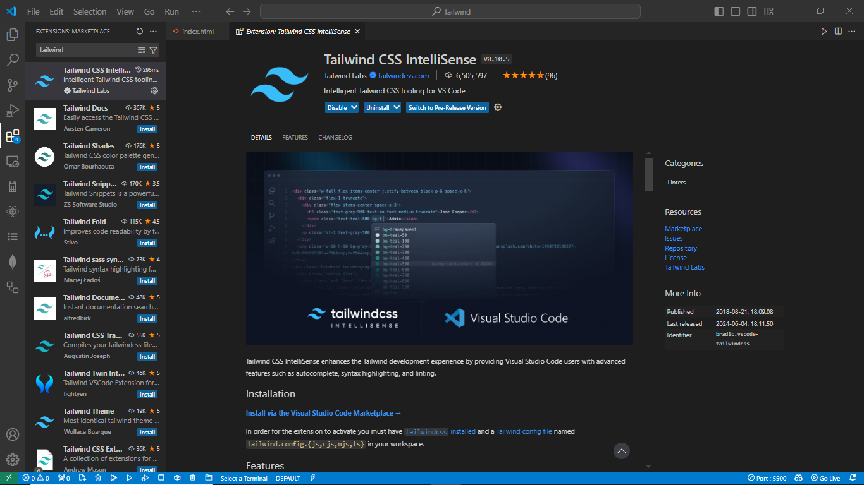


Slide 2
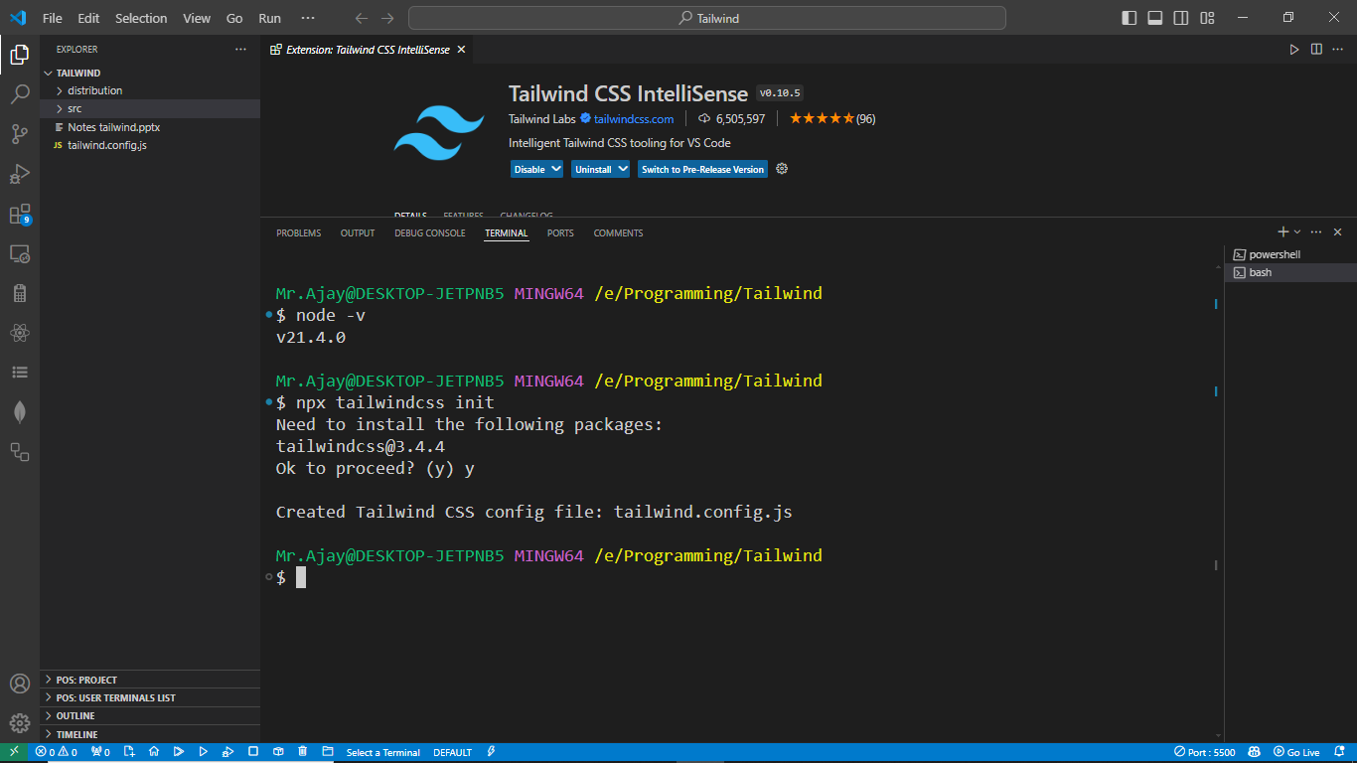
npx- Node Package Executor
npx tailwindcss init

Slide 3
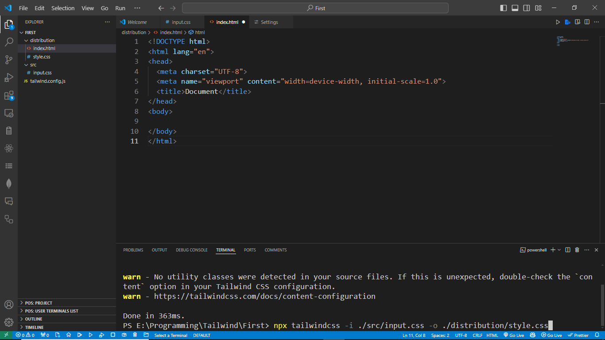

Slide 4
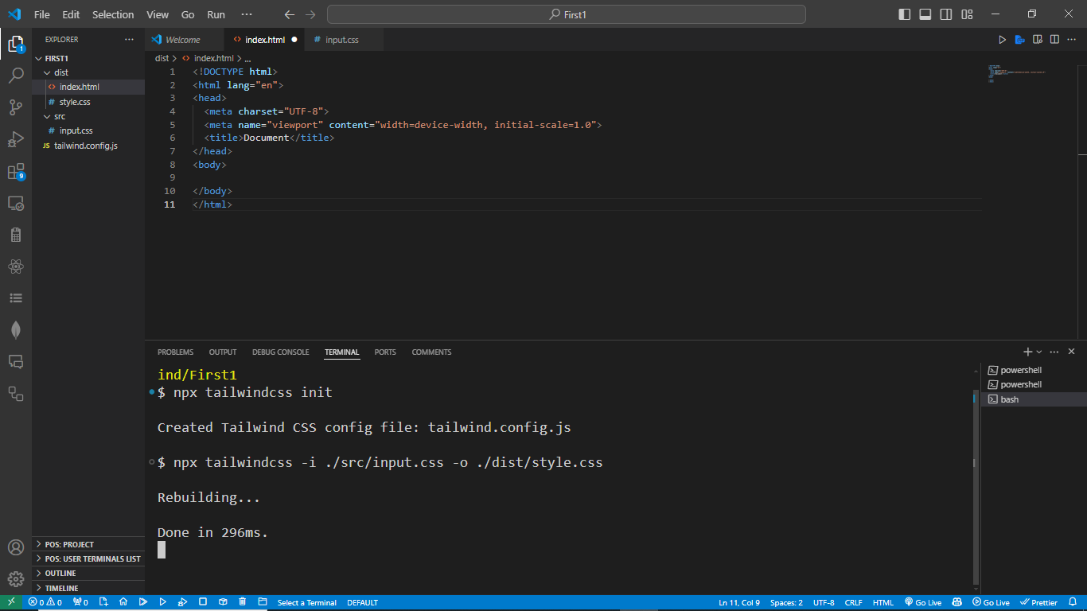
npx tailwindcss -i ./src/input.css -o ./dist/style.css
This file auto create,

Slide 5
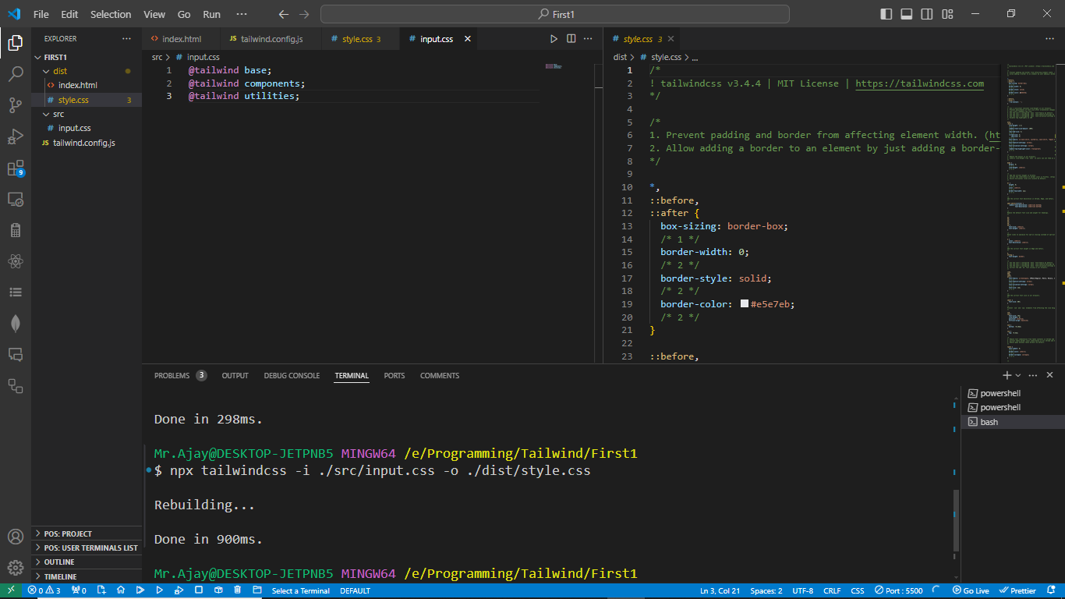

Slide 6
